Slide 1

Hotel Occupancy Forecast
Tingting Duan – Data Science 3
Instructor – Michael Holloway

Slide 2
Oc·cu·pan·cy /ˈäkyəpənsē/
The percentage of all rooms that are occupied at a given night.

Slide 3
Motivation
All-In-One hotel metasearch engine
Google flight price forecast

Slide 4
Why this topic
Forecasting accuracy depends on 1) input data quality, and 2) modeling.
Forecasting will never be accurate without “business on the book” data (% rooms booked for this Friday).
STR has both historical and “business on the book” data submitted by hotels globally.

Slide 5
Goal
Predicting hotel occupancy 4 days out
For example: Today is Monday, and I am forecasting Friday’s occupancy.
4 days out prediction would still be valuable as the booking window has been truncated in recent years (e.g., Hotel Tonight).

Slide 6
Data
Hotel attributes:
Class (e.g., luxury vs. economy)
Average daily price
Hotel occupancy last year
Hotel occupancy this year (pre COVID-19)
% of rooms booked 4 days prior to the forecasting/target date
% of rooms booked 1 week prior to the forecasting/target date
% of rooms booked 2 weeks prior to the forecasting/target date
% of rooms booked 3 weeks prior to the forecasting/target date
% of rooms booked 4 weeks prior to the forecasting/target date

Slide 7
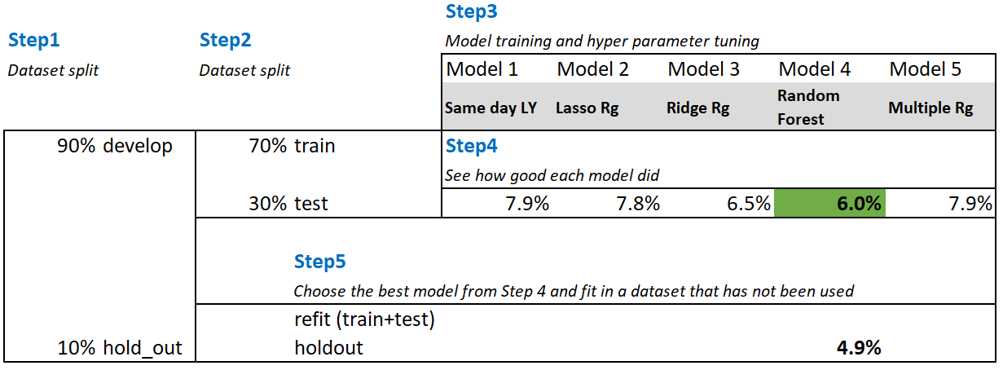
Machine Learning Model Set-up

Slide 8
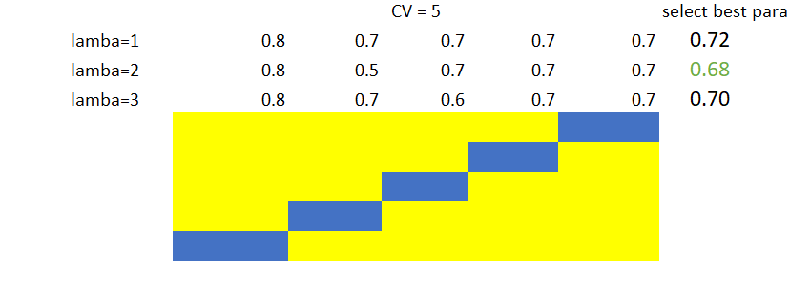
Machine Learning Model Set-up Cont.

Slide 9
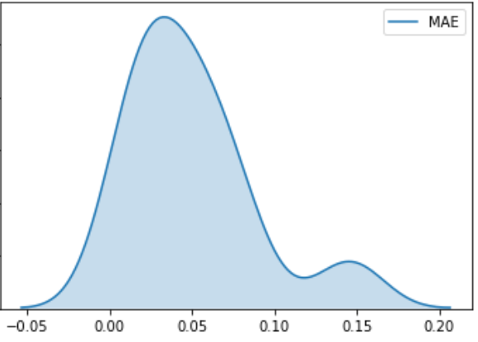
Results Measure
Mean Absolute Error: 4.9%
For example:
Forecasted Occupancy: 90%
Actual Occupancy: 85.1%
On average, the model is off by 4.9% in hotel occupancy.
Without any modeling (i.e., merely using the same-day last year’s data), the model is off by 8% in hotel occupancy.
The model improved the accuracy by 37.5%
(5% - 8%)/8%

Slide 10
Demo and Model Interpretation

